Slide 1
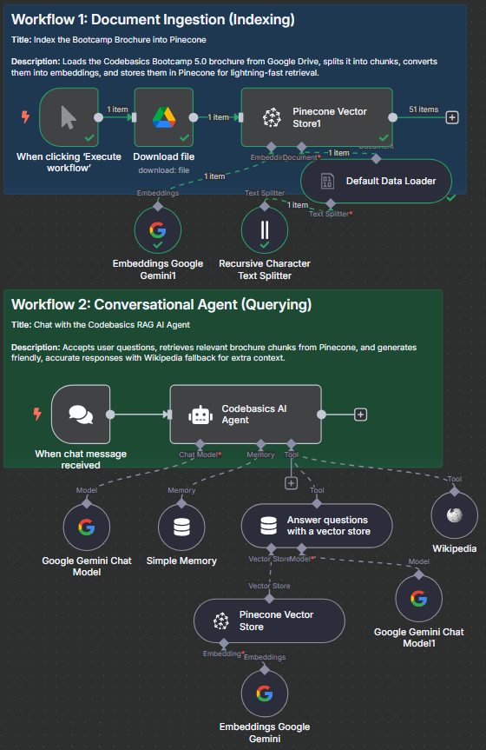
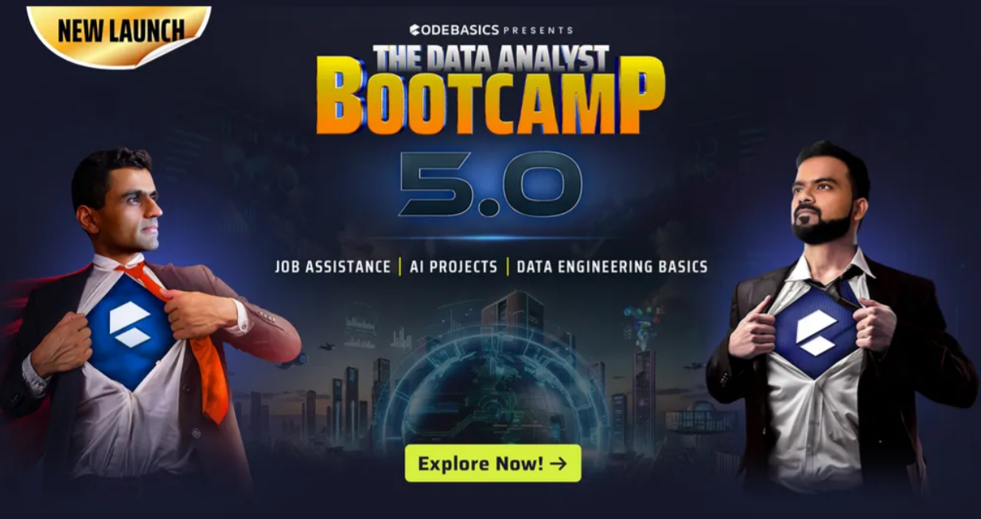
Built with n8n • Pinecone Vector DB • Google Gemini (PaLM)
Codebasics RAG AI Agent : Instant Answers for Data Analytics Bootcamp 5.0
sachin savkare

Slide 2
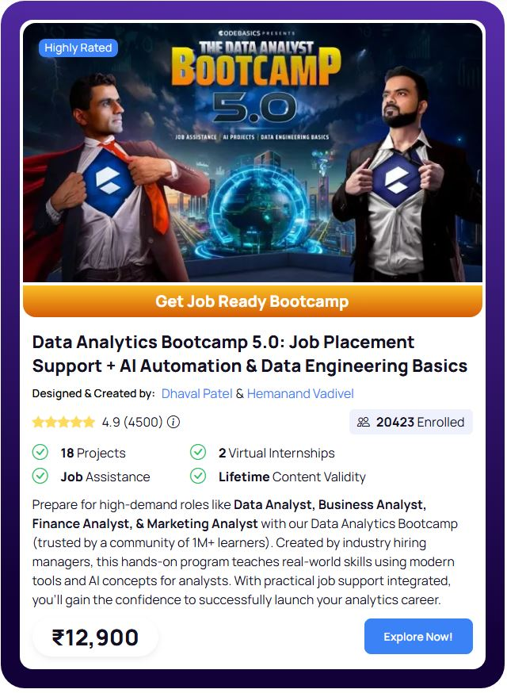
Why this project matters
Instantly answers Codebasics Data Aalystics Bootcamp 5.0 queries using the official brochure and web search (no guessing).
Grounded responses: searches the indexed brochure first, then falls back to Wikipedia.
Fast, cost-efficient way to support learners, marketing, and admissions teams.
This agent doesn’t hallucinate , it retrieves brochure content from a vector database and then generates friendly answers. Great for prospects, students, and internal teams who need fast, accurate info.

Slide 3
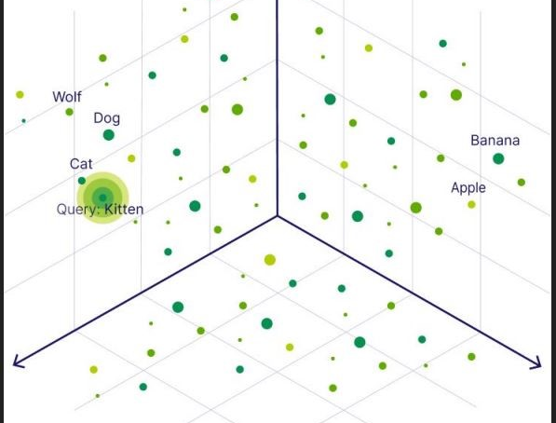
Core Concepts (RAG + Vectors database)
1. What is RAG? : Retrieval-Augmented Generation (RAG)
Powerful technique that combines two approaches. Helps AI models provide more accurate and relevant answers.
Retrieval : Retrieves relevant information from external sources
Generation : AI uses this information to generate an answer
2. Why RAG Matters
No Guessing : AI Assistant
It’s not going to make up an answer based on training data
More reliable and up-to-date information
3. What are Vector Databases?
RAG needs a way to store and retrieve data efficiently
Vectors
Data stored in “vectors”
Numerical database that represents
the meaning of words, text, etc.
Relevant information quickly

Slide 4
Workflow 1: Document Ingestion (Indexing)
1.Execute Workflow (Trigger)
1. Manually start indexing.
2. Pull brochure PDF (binary) from Drive.
3. Insert vectors into sample-codebasics-index1.
4. Convert PDF binary into text items.
5. Create 768-dim vectors for each chunk.
6. Split content into 1000-char chunks.
2. Google Drive : Download File
3. Pinecone Vector Store - Insert Documents
4. Default Data Loader
5. Embeddings (Google Gemini)
6. Recursive Character Text Splitter

Slide 5
Workflow 2: Conversational Agent (Querying)
1. Chat Message Received
1. User’s question triggers the flow.
2. Orchestrates retrieval + generation using a system message.
3. Generates friendly, emoji-rich replies.
4. Keeps session context (last 10 interactions).
5. Generates friendly, emoji-rich replies.
6. Use for general background if no brochure match.
7. Returns nearest neighbour text chunks.
8. Send final, grounded answer to chat UI.
2. Codebasics AI Agent
3. Google Gemini (Chat)
4. Memory (Simple Memory)
5. Answer with Vector Store (Tool)
6. Wikipedia (fallback)
7. Pinecone Vector Store : Retrieve Documents
8. Return/Output

Slide 6
Thank you
sachin savkare sachinsavkare08@gmail.com https://www.linkedin.com/in/sachin-savkare/

